Slide 1
Proof and Logics

Slide 2
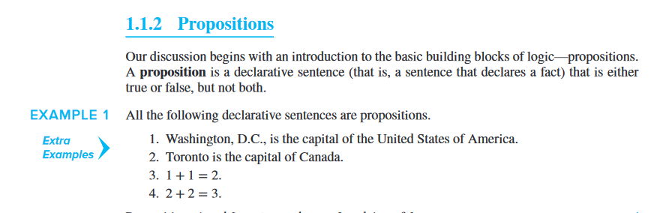
Proof and Logics

Slide 3
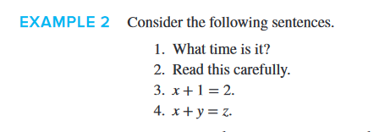
Proof and Logics

Slide 4
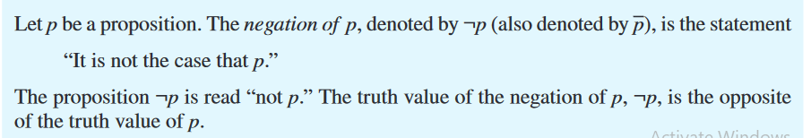
Negation of a proposition

Slide 5
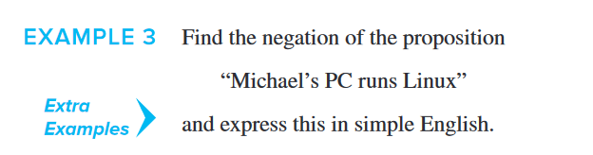
Negation of a proposition

Slide 6
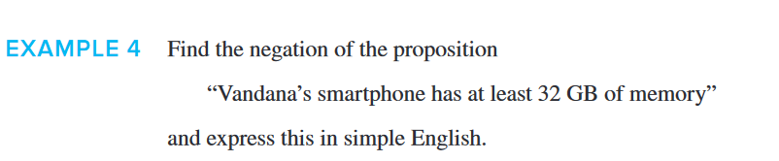
Negation of a proposition

Slide 7
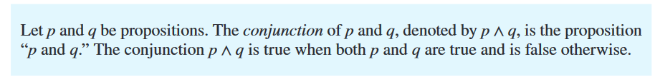
Conjunction of propositions

Slide 8
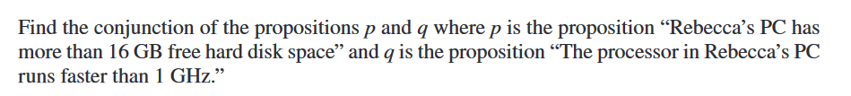
Conjunction of propositions

Slide 9
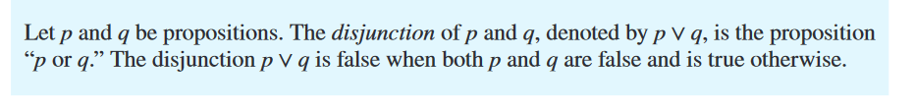
Disjunction of propositions

Slide 10
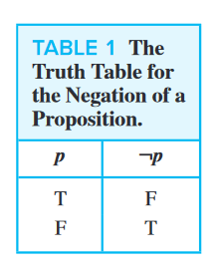
Truth table of Negation

Slide 11
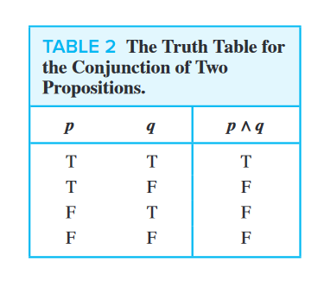
Truth table of Conjunction

Slide 12
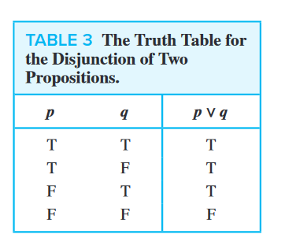
Truth table of Disjunction

Slide 13
Truth table of Disjunction

Slide 14
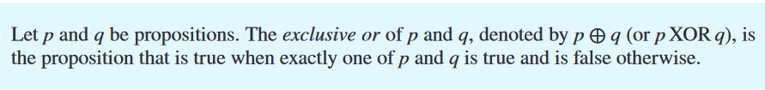
Exclusive OR or XOR

Slide 15
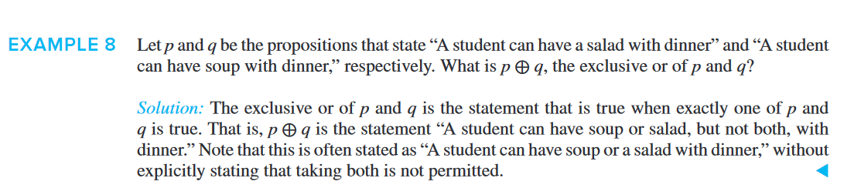
Exclusive OR or XOR

Slide 16
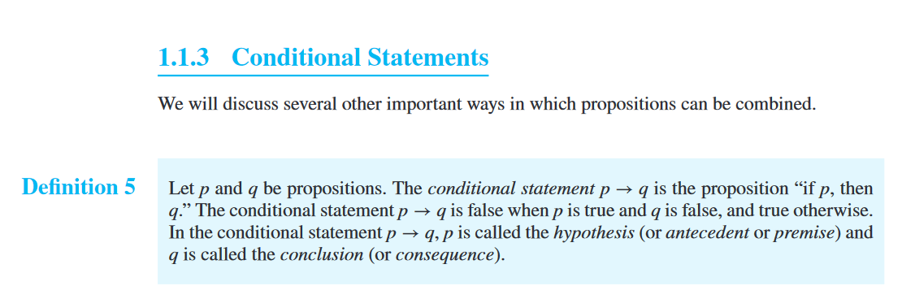
Conditional statements

Slide 17
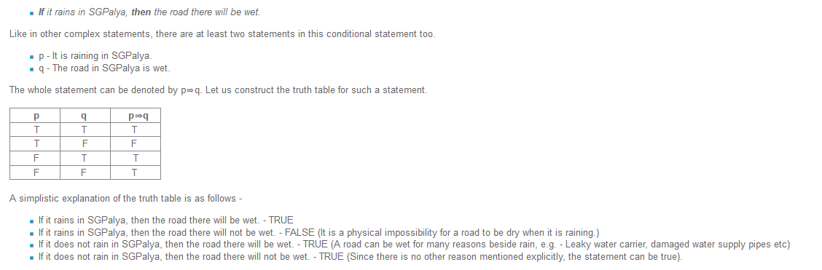
Conditional statements

Slide 18
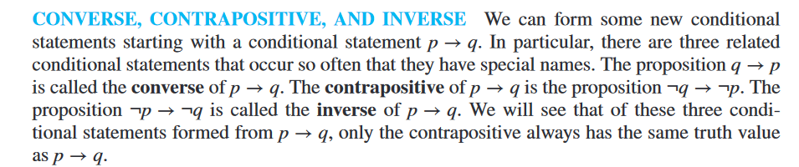
Converse, Contrapositive and Inverse

Slide 19

Question 1

Slide 20
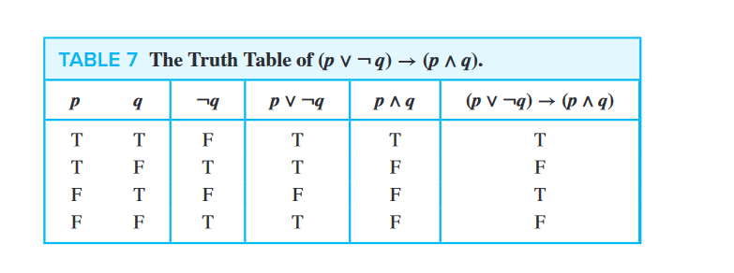
Question 1

